Slide 1
EBook Reader and Retail System
--By Hank Bennett, Scott Hartsell, Mateo Lopez Moncaleano, Yi Zhou

Slide 2
Topics
Introduction
System Diagram
Technologies
Schema
Constraints
ER/ERR Diagram
Web interface

Slide 3
Introduction
The eBook Reader and Retail System serves as a user-friendly platform designed to assist users in logging in and accessing their personal library, which is a collection of books and various formatted files. This platform not only facilitates browsing but also enables users to purchase new books.
Each tile within the system's interface contains the book's cover, along with a concise book summary and relevant information positioned below the cover image.
Users can open their selected books and engage in a delightful page-by-page reading experience. The system keeps track of the user's progress ensuring a smooth and uninterrupted reading experience, especially when turning pages.

Slide 4
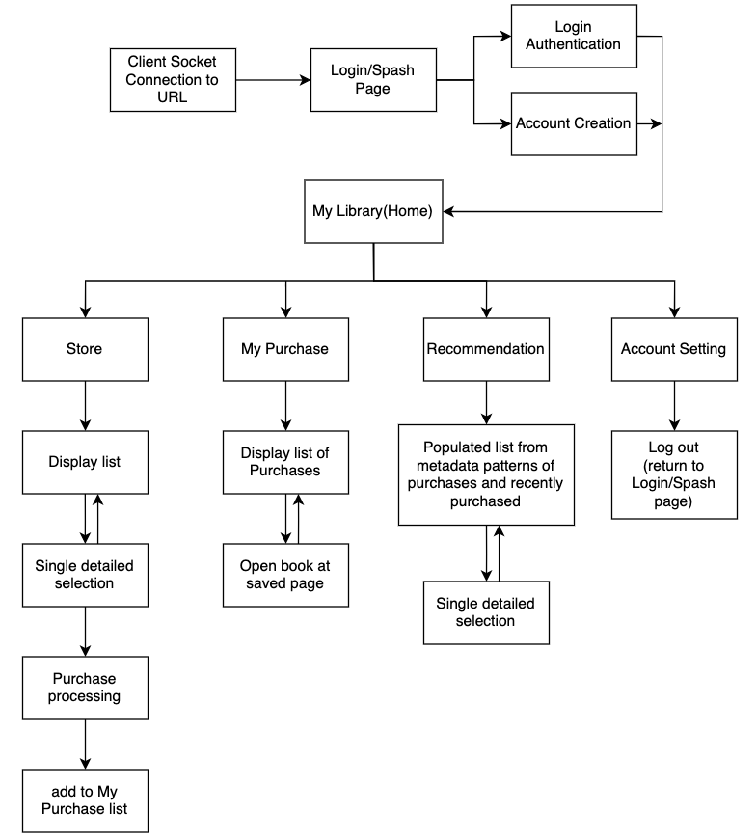
System Design

Slide 5



Technologies Used
Database: MySQL
Front End Interface: HTML/JavaScript
Back End (Web server): PHP

Slide 6
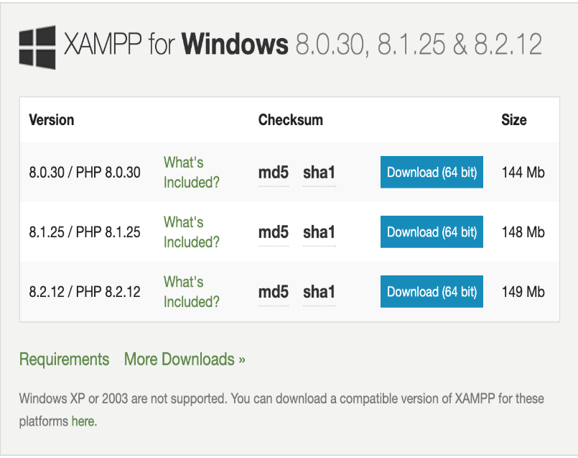
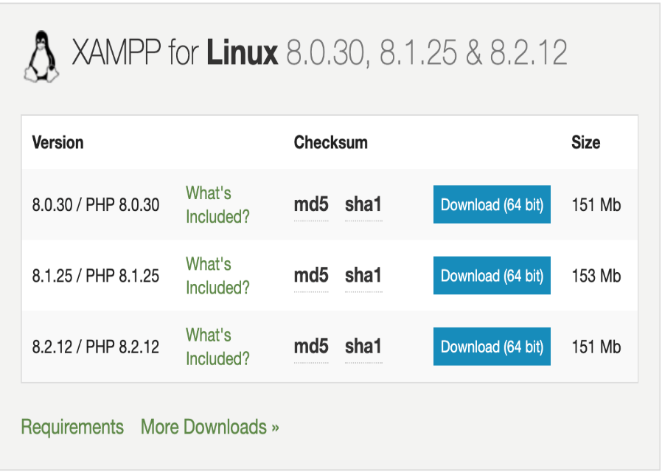
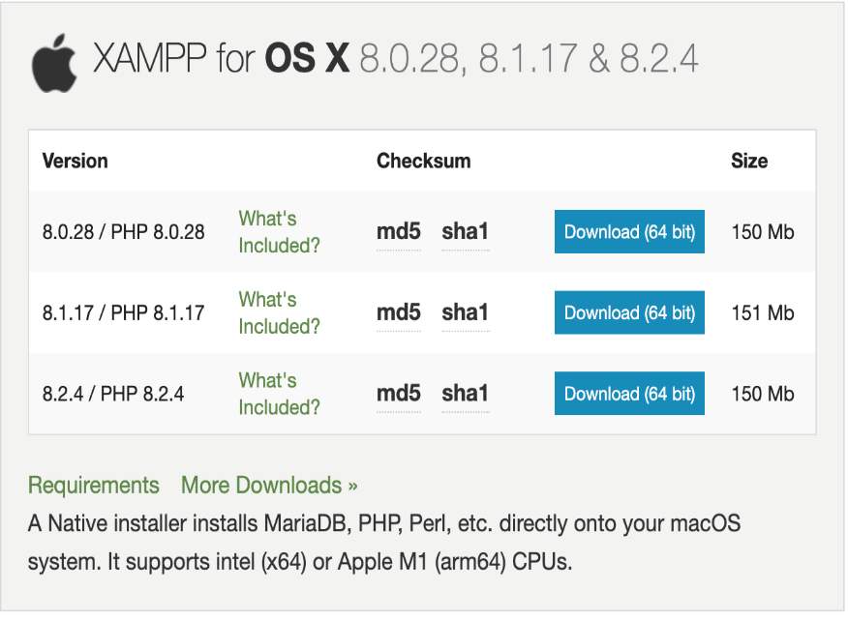
Development Environment
XAMPP is a free and open-source cross-platform web server solution stack package developed by Apache Friends. XAMPP is designed to make it easy to set up a local web server environment for development and testing purposes. It provides a convenient way to install and configure Apache, MySQL, PHP, and Perl on a single machine.

Slide 7

MySQL
phpMyAdmin is a free software tool written in PHP designed to handle the administration of MySQL over the web.
phpMyAdmin supports various operations on MySQL and MariaDB. We can perform common operations through the user interface, such as managing databases, tables, columns, relationships, indexes, users, permissions, etc., and we can also directly execute any SQL statement.

Slide 8
Front End Interface – HTML
HTML (Hypertext Markup Language) is the standard markup language used to create and design web pages. It provides a structure for content on the web, defining elements like headings, paragraphs, images, links, and more.
HTML works in conjunction with CSS (Cascading Style Sheets) and JavaScript to create visually appealing and interactive web interfaces. While HTML defines the structure of content, CSS is used for styling and layout, and JavaScript adds interactivity and dynamic behavior to the front end.

Slide 9
Back End (Web server) -- PHP
PHP ((Hypertext Preprocessor) is a server-side scripting language designed for web development. It is embedded within HTML code and executed on the server, generating dynamic content. PHP is often used for tasks like database access, form processing, and other server-side functionalities.
PHP handles server-side logic and dynamic content generation. It allows developers to create web applications that can interact with databases, handle user input, and perform various tasks on the server before sending the result to the client's browser.

Slide 10
Schema
User_login:
user_id | username | login_password
Book_info:
book_id | book_cover | title | author | pub_date | publisher | isbn | summary
Genre_tags:
book_id | fiction | nonfiction | fantasy | action_adventure | mystery | thriller | self_help | graphic_novel | inspariation | romance | horror | comedy
Library:
user_id | book_id
Book_content:
book_id | page_num | content

Slide 11
Table
user_login
Name | Type | Length
user_id | INT | 11
username | VARCHAR | 20
login_password | VHARCHAR | 15
book_info
Name | Type | Length
book_id | INT | 11
book_cover | VARCHAR | 255
title | VARCHAR | 100
author | VARCHAR | 100
pub_date | DATE
publisher | VARCHAR | 100
isbn | VARCHAR | 100
summary | MEDIUMTEXT

Slide 12
Constraints
Entity integrity constraint:
Every User_login record must have a value for user_id;
Every Book_info record must have a value for book_id;
Uniqueness Constraint:
Every user_id should be unique for each user_login record;
Every book_id should be unique for each Book_info record;
Referential integrity constraint:
The value of book_id in genre_tags record must relate to book_id in the book_info record;
The value of user_id in library record must relate to the user_id in the user_login record and the value of book_id in library record must related to the book_id in book_info record;
The value of book_id in book_content record must relate to the book_id in the book_info record.

Slide 13
ER/ERR diagram
12 genre_tags
genre_tags
Book_id
Book_cover
Recommend
Title
Store
Purchase
User
Books
Mylibrary
Pub_Date
Login
Author Name
Summary
ISBN
Keeps track of
Authentication system
Book_content
User_id
Password
Book_id
Page Number
Content

Slide 14
Web interface
Book_detail & Purchase Page
Login Page
Store Page
Home Page
Recommendations Page
Logout

Slide 15
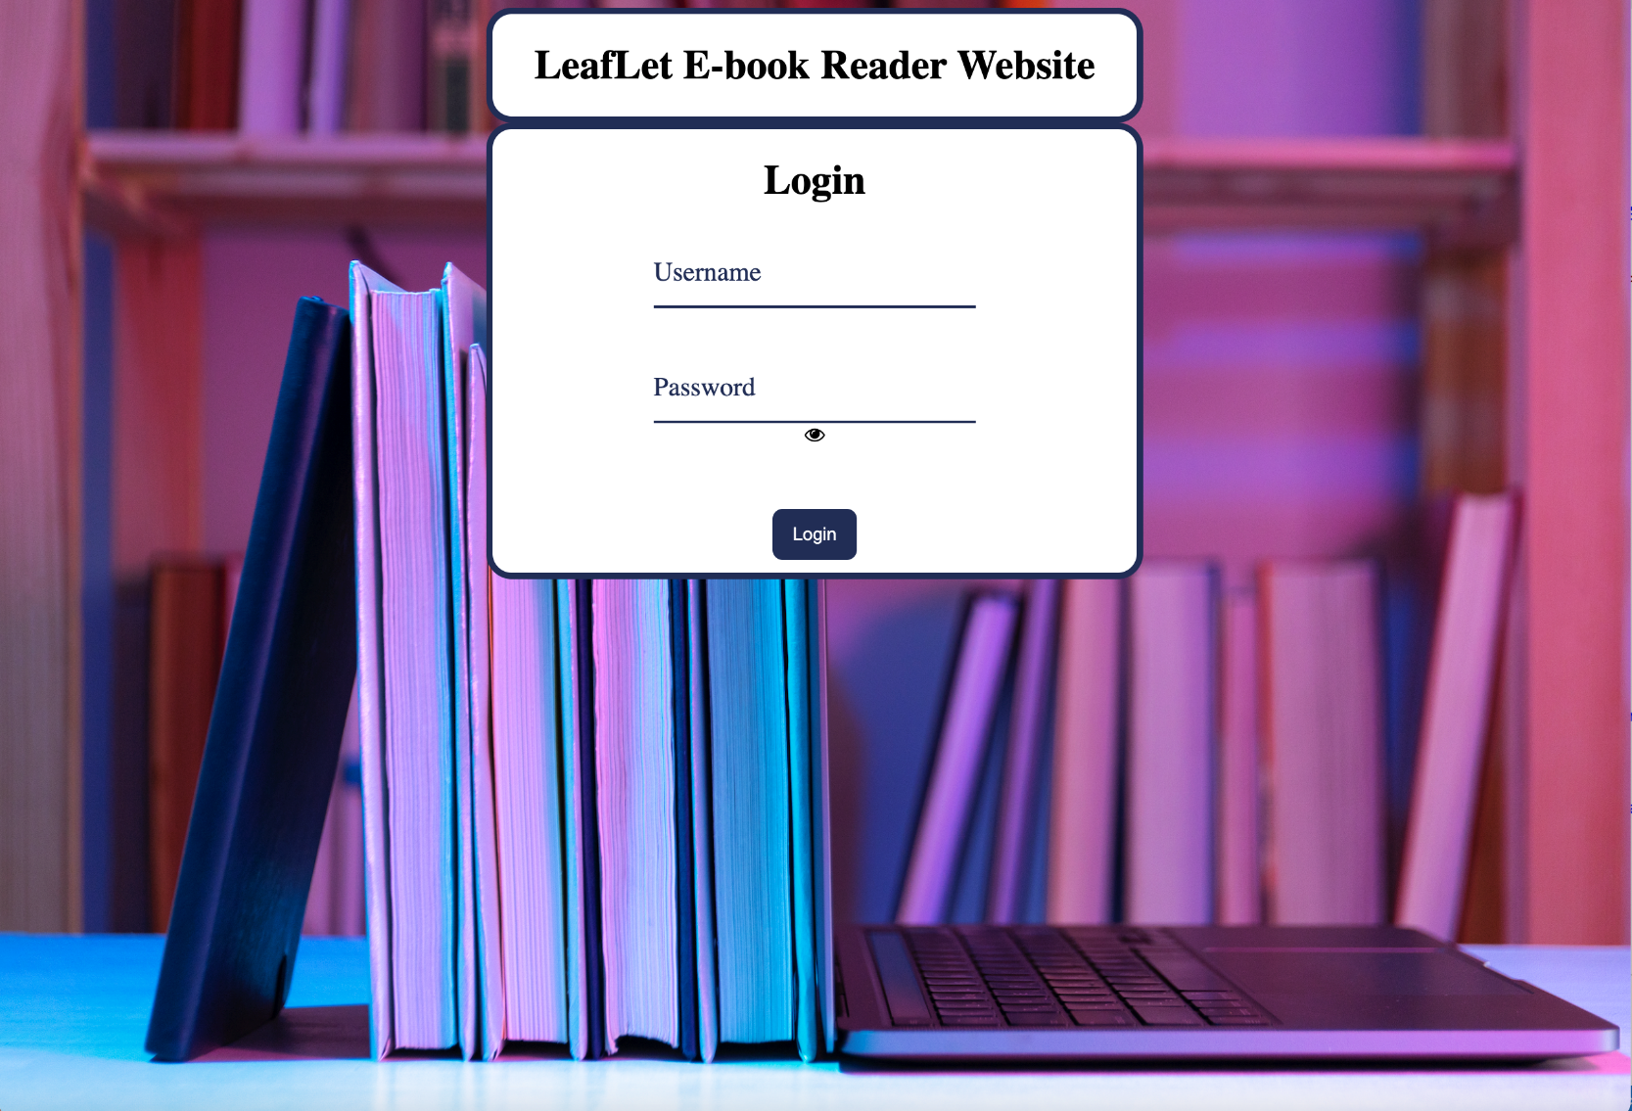
Login/Logout Page

Slide 16
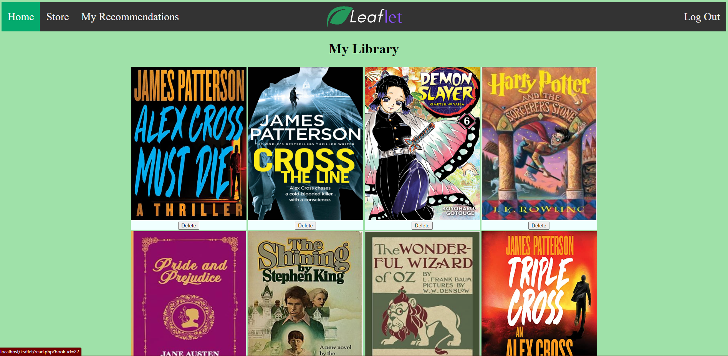
Home Page

Slide 17
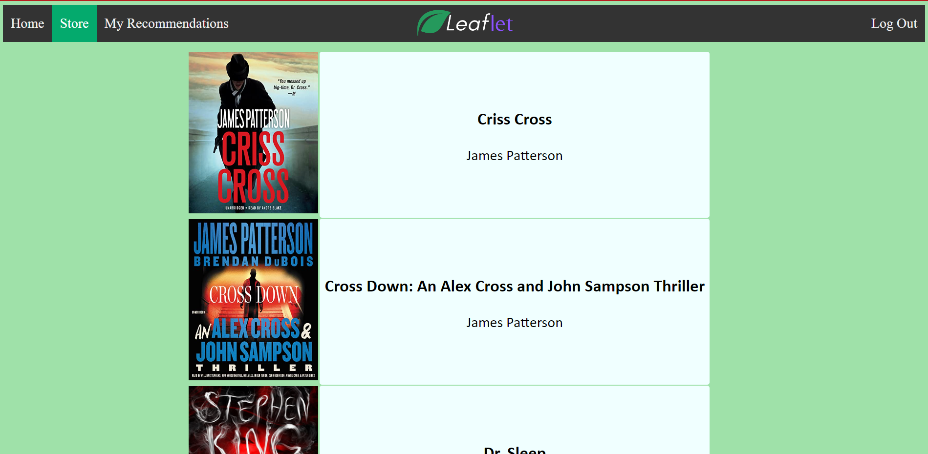
Store Page

Slide 18

Book Detail & Purchase Page

Slide 19
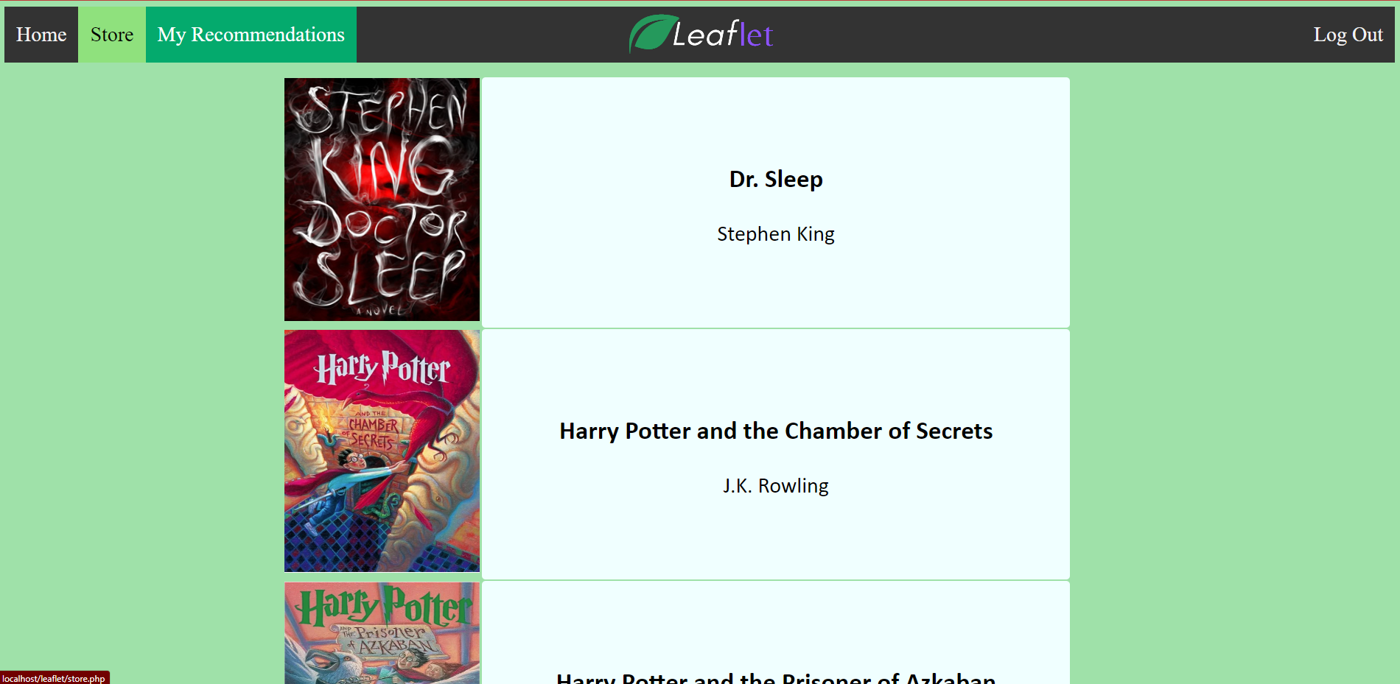
My Recommendation Page

Slide 20
THANK YOU!

